Slide 1
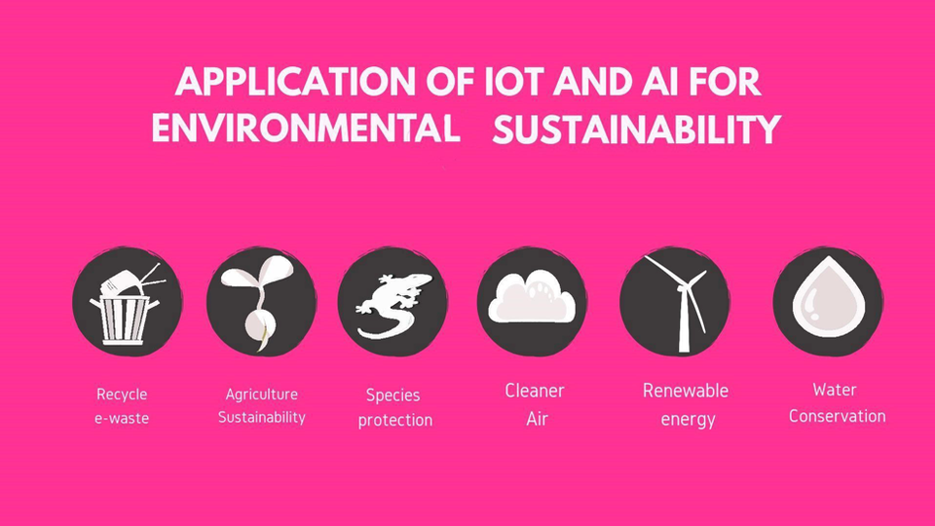
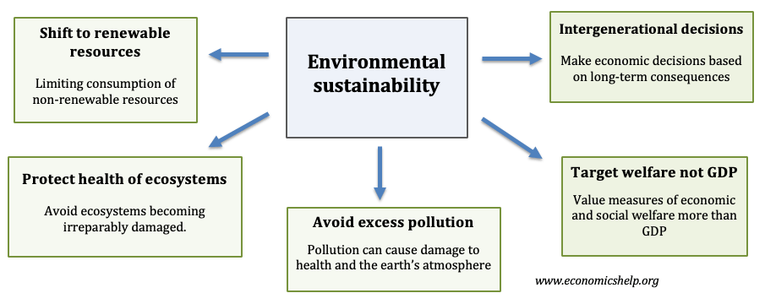
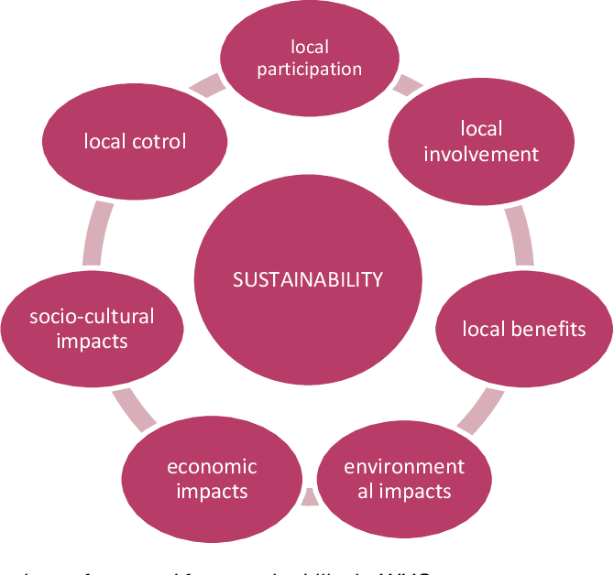
Green Chemistry for Environmental Sustainability
Introduction
Green chemistry does not means Green as a color but an alternative to design of chemical products and processes that reduce, minimize or eliminate the use and generation of hazardous substances. Green chemistry is based on the fundamental or outstanding principles that when implemented right will maximize the incorporation of raw materials into the final products with environmentally-friendly
substances and methodologies.
How IoT And AI Can Enable Environmental Sustainability
Using IoT and AI for reducing e-waste
Applying IoT and AI for agricultural sustainability
Applying IoT and AI for agricultural sustainability
Using IoT and AI for cleaner air
Using IoT and AI for maximizing renewable energy technologies
Applying IoT and AI for Smart Water Projects.
What is Environmental Sustainability?
Environmental sustainability is defined as responsible interaction with the environment to avoid depletion or degradation of natural resources and allow for long-term environmental quality. The practice of environmental sustainability helps to ensure that the needs of today's population are met without jeopardizing the ability of future generations to meet their needs.

